Slide 1
Direct driving the QUAD
ESL 989 electrostatic speaker
Jan Didden
ETF 2022, Baarlo, The Netherlands

Slide 2
Where I am coming from
Lifelong fascination with audio electronics
Writing for Wireless World, ELRAD,
Costruire HiFi, Audio Amateur, Elektor, L’Audiophile
Chairman NL-section AES, AES Life member
Presentations at AES, RMAF, ETF, Burning Amp, YouTube channel
One patent on Error Correction
Publisher/Editor Linear Audio bookzine
Technical Editor AudioXpress

Slide 3
An ESL 63/989 primer
Direct drive – why bother?
Requirements – voltage, current, freq. response
Design considerations
Realization – schematics, system diagram
Software features
System set-up

Slide 4
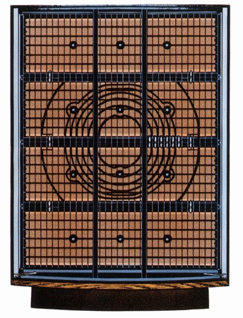
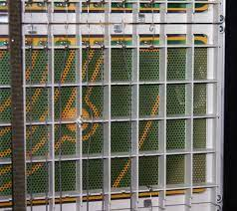
ESL 63 construction details
Top & bottom are bass panels
Center panels are mid/high panels
Individually driven concentric stator rings

Slide 5
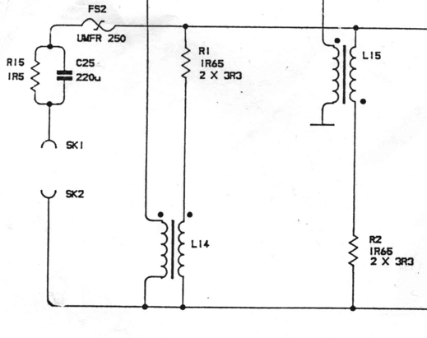
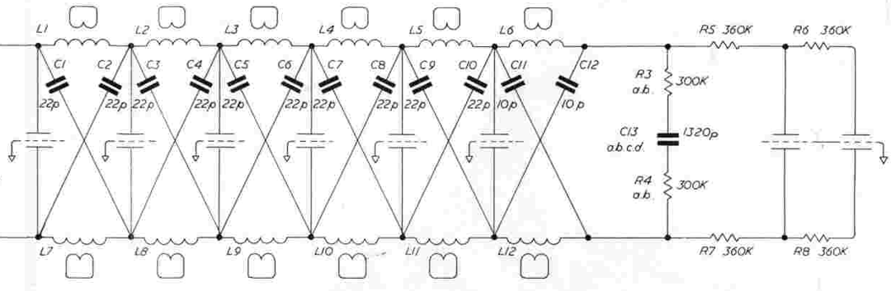
QUAD ESL 63
transmission line stator drive
(for 989 add two bass panels)

Slide 6
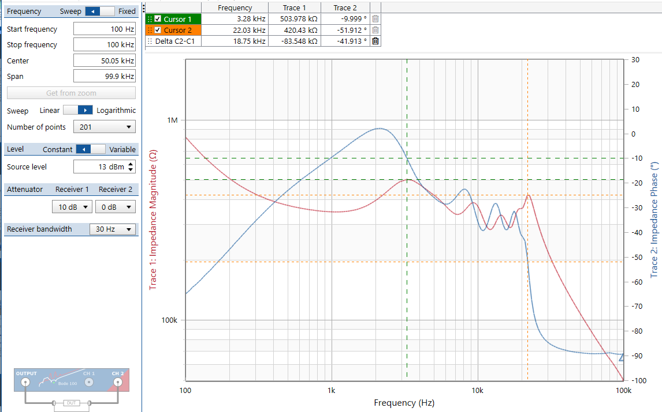
ESL 63 stator-stator input impedance

Slide 7
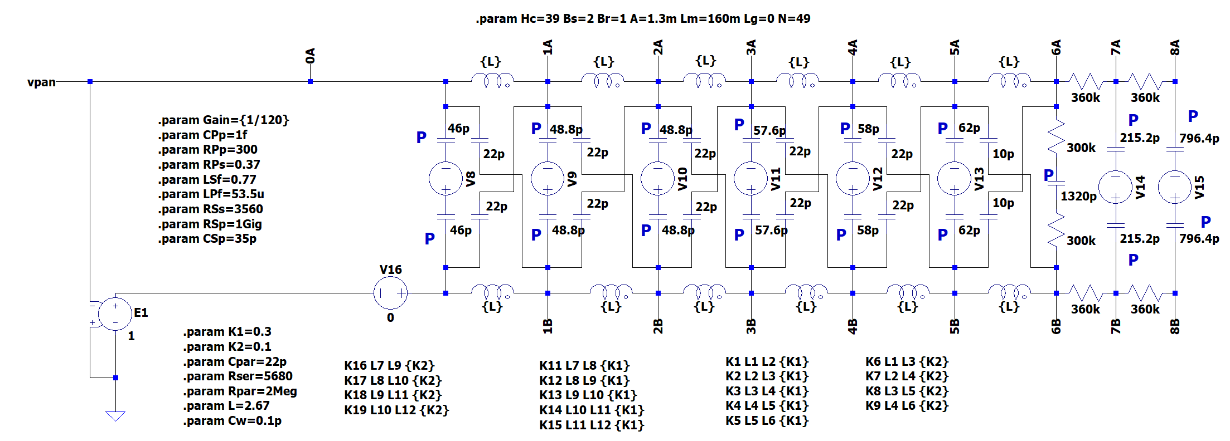
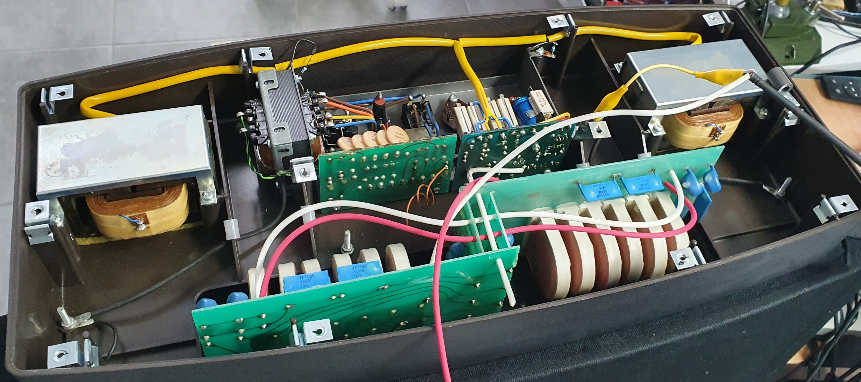
Amplifier requirements
Two opposite phase drive voltages up to 5kV pk-pk
Bridged load signal currents of up to 10mA pk-pk
Notes:
There is also a more complete model that includes things like baffle step and air load mass.
Inductors are core, 2.78H (!), and are coupled with adjacent coils and damped.
The sections at the left model the high freq. sections, and at the right are the bass panels.
Bass panels have the highest capacity but are ‘ isolated’ by the transmission line sections.

Slide 8
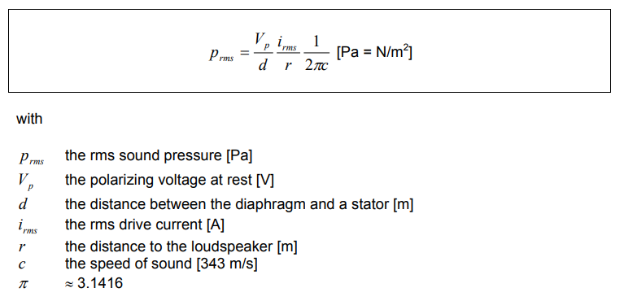
Design considerations – 1
  ‘Walker Equation’
Initial all-solid-state design, based on IXYZ 4.5kV FETs and IGBTs
Abandoned due to very high parasitic capacitances and small SOA

Slide 9
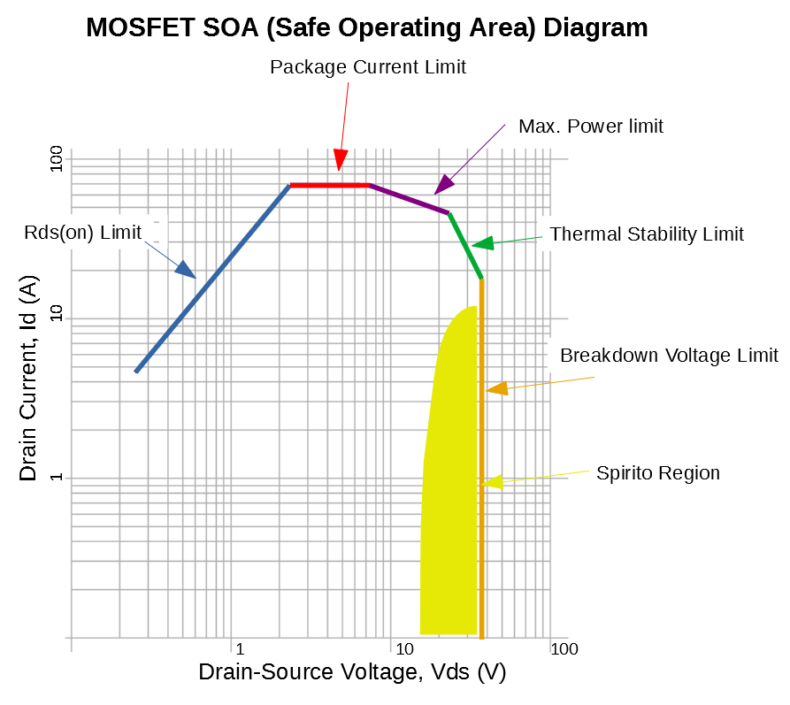
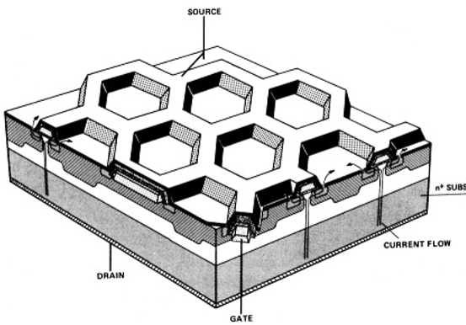
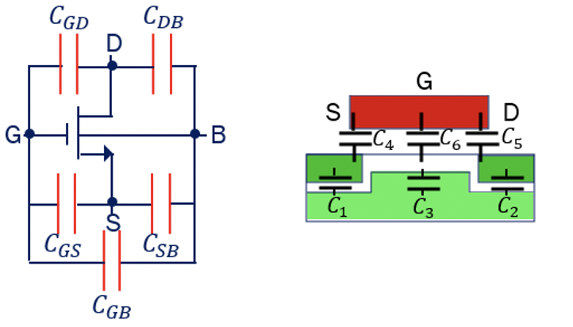
Issues with HV FETs/IGBTs in linear applications
The Spirito Effect: each cell has the same gate-to-source voltage and the same capacitances but not the same gain. A higher gain cell conducts more current, causing a hotspot, leading to secondary breakdown.
High gate charge/discharge currents cause distortion.

Slide 10
Design considerations - 2
Over to the dark side - compactron 6HS5 beam triode tubes!
+/- 2.2kV design instead of +4.4kV to limit high voltage in box
Current output into capacitive load for 1st order open loop roll off
Rely on stable NFB for lowish Zout
Monoblocs to limit cable length (capacitance)
Software safety provisions

Slide 11
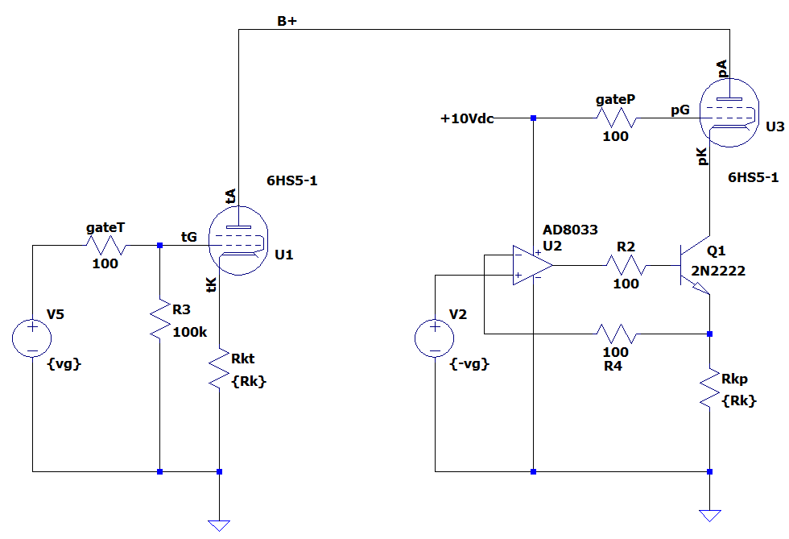
Triode/Beam Triode Common Cathode versus
Common Grid/transconductance drive

Slide 12
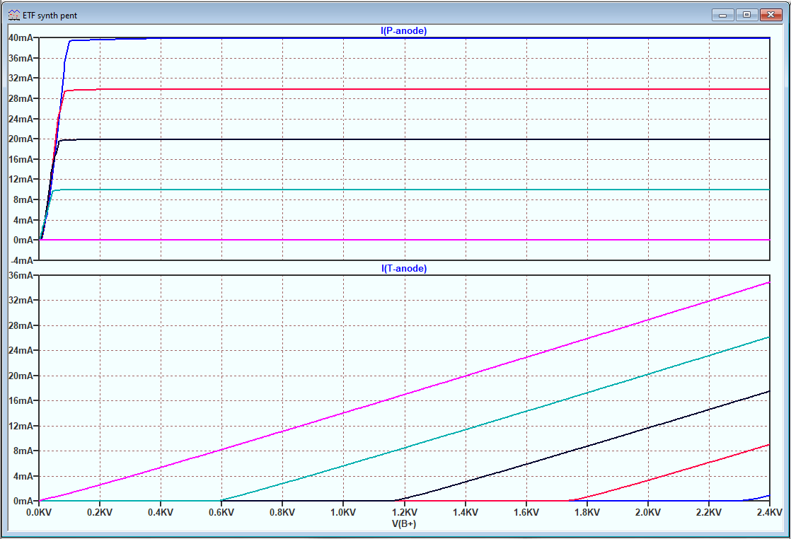
Common Grid drive turns a triode into a pentode

Slide 13
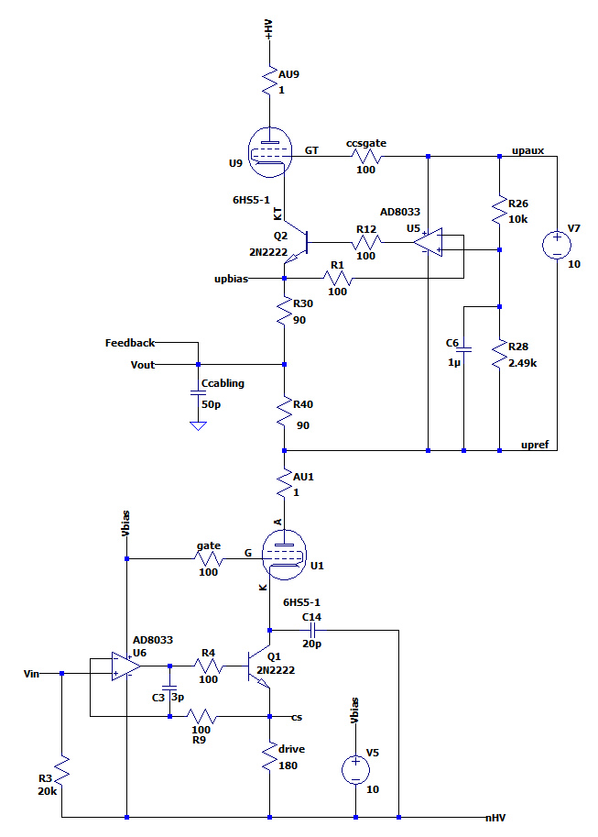
Basic output stage
Modulated current source
Next to tackle:
Floating heater & bias for top tube;
Heater & bias at -2.2kV for bottom tube

Slide 14
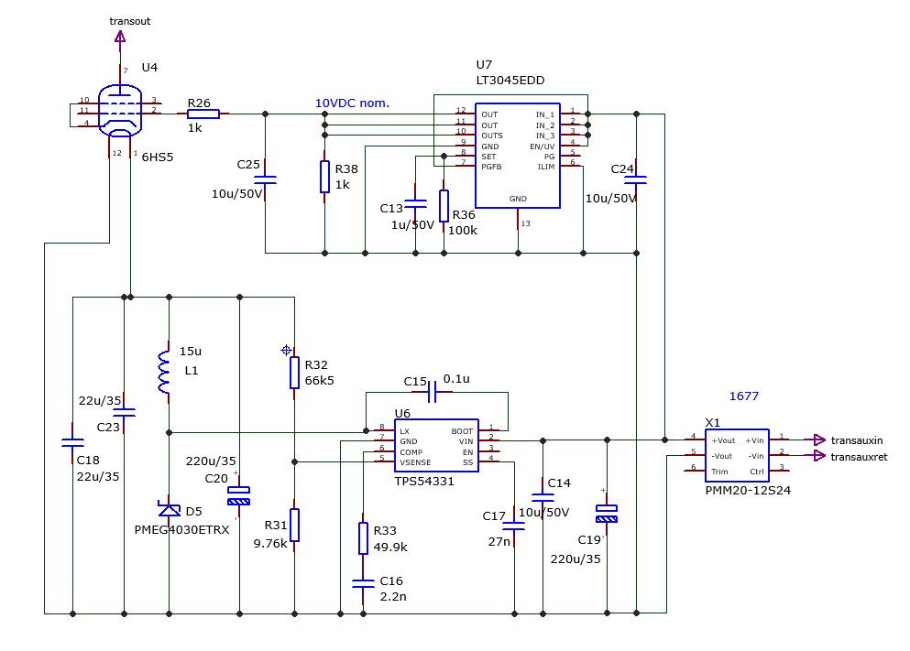
Isolated heater & bias voltages

Slide 15
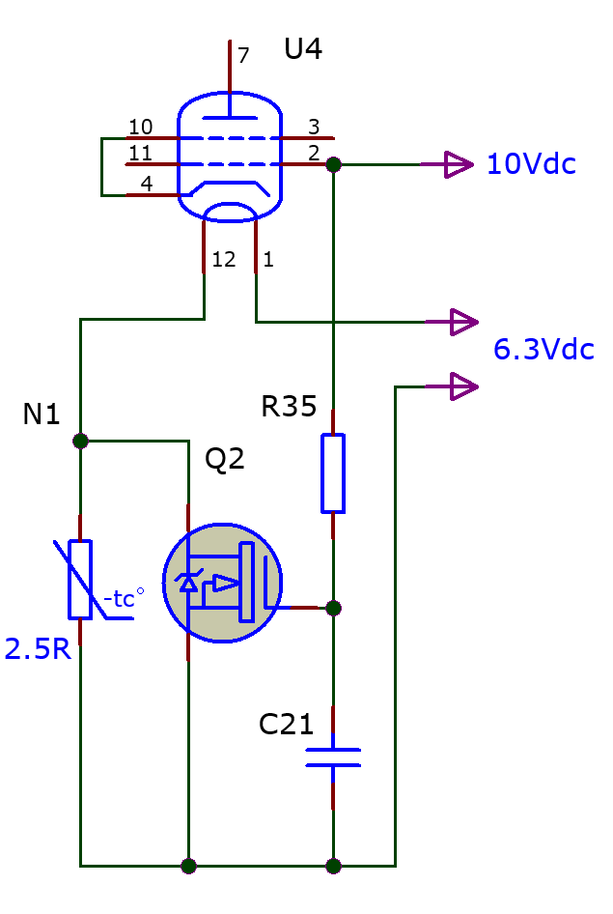
Heater soft-start

Slide 16
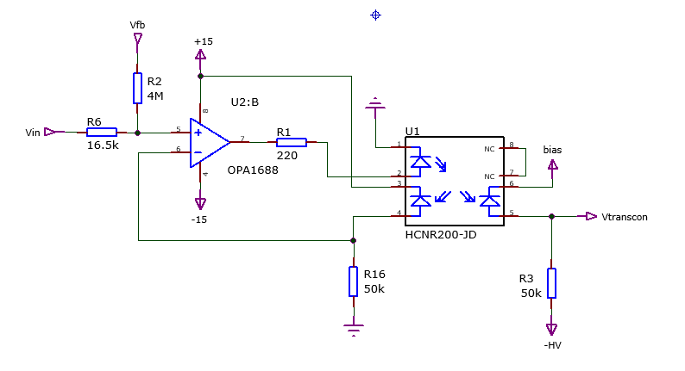
Next to tackle:
Bringing the signal to -2.2kV reference
Linear isolated optocoupler HCNR200/TIL300
V(R16) = Vin
V(R3) = Vin

Slide 17
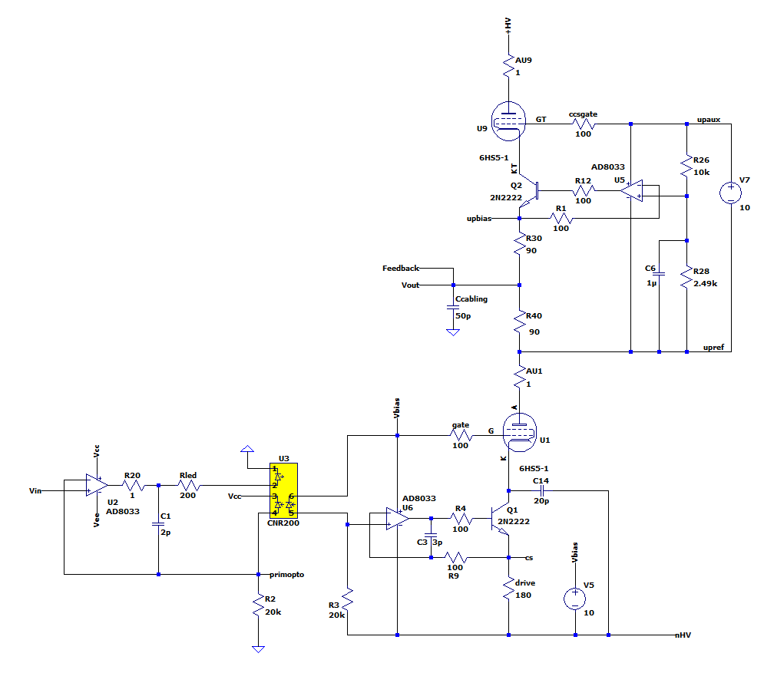
Forward audio path

Slide 18
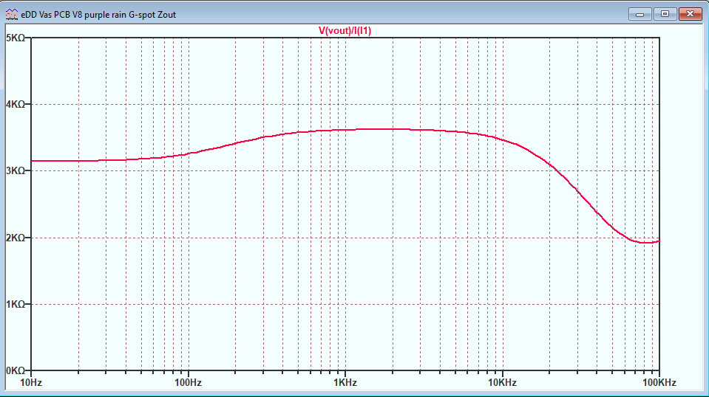
Output impedance (simulated)

Slide 19
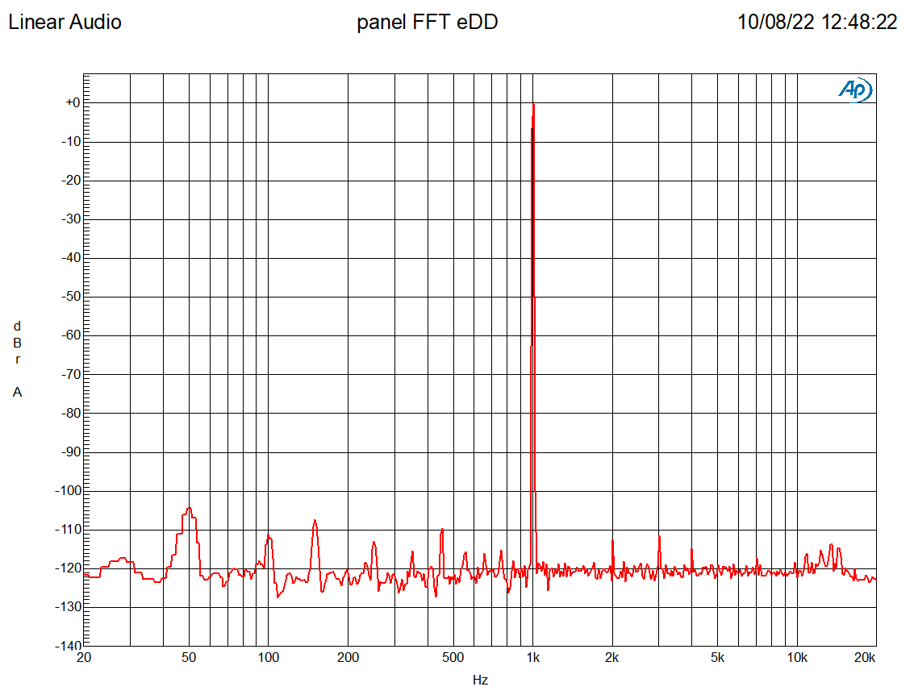
Distortion at the stators – direct drive

Slide 20
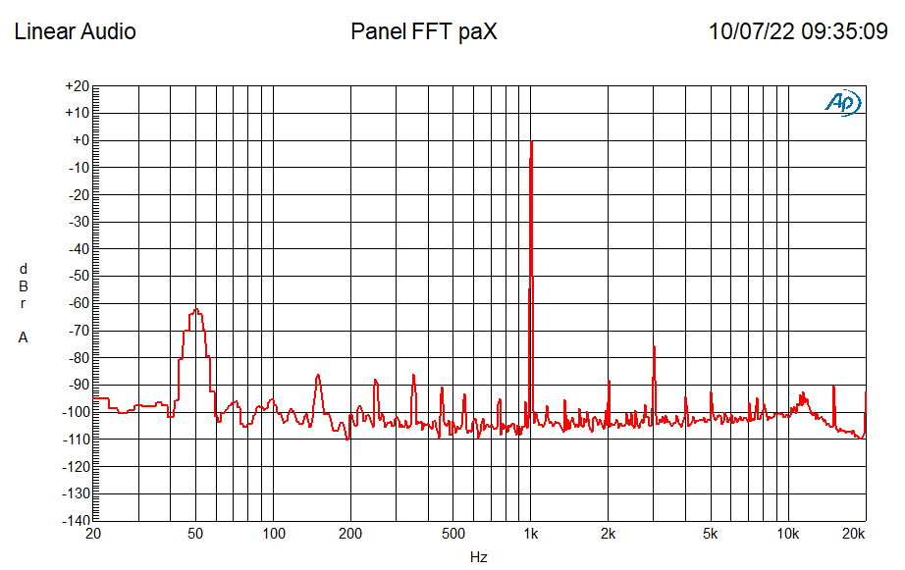
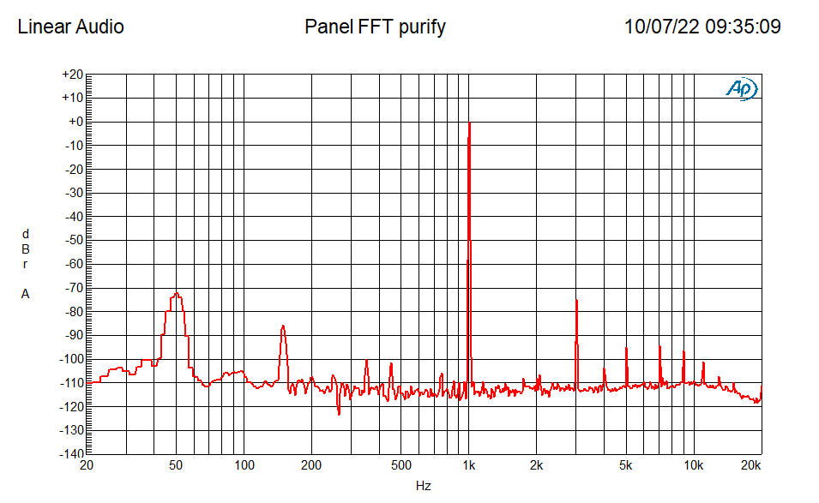
Distortion at
the stators –
paX & Purifi

Slide 21
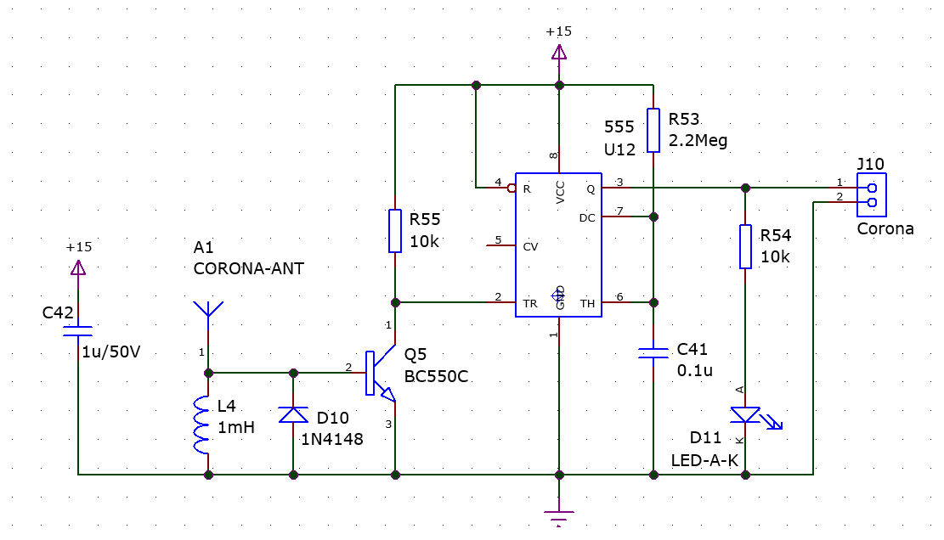
Software features
Safety
At start-up: check cable connection
During operation:
  Watch cable connection
  Watch output offset
  Watch corona discharge
  … shut down if error
Operation
Remote control
  Active/standby
  Speaker switching

Slide 22
System level
A/B drive comparison
Sources and DACs

Slide 23
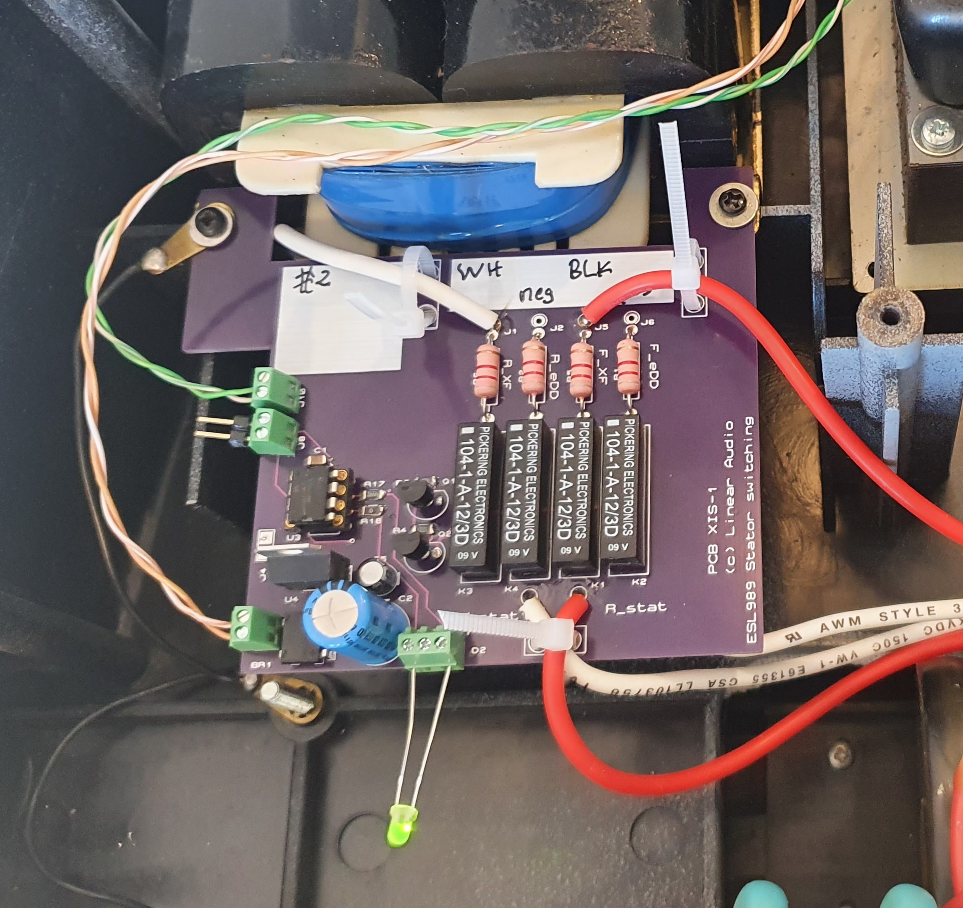
Speaker switching
Stator switching
step-up output vs. direct drive output

Slide 24
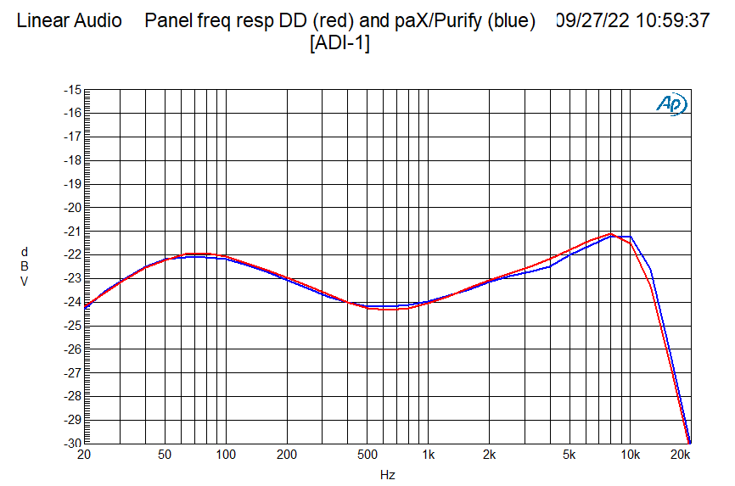
Stator drive response matching
Stator switching step-up output vs. direct drive output

Slide 25
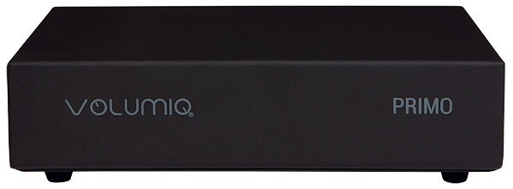
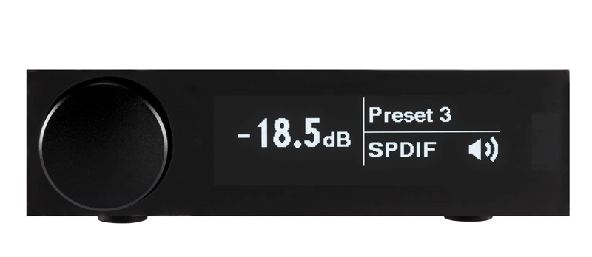
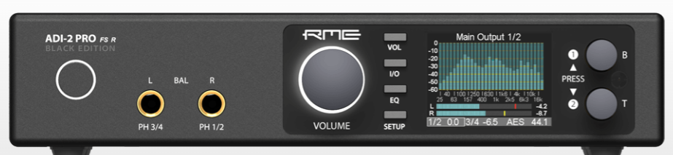
System components
Source:
Volumio Primo streamer
Wireless, USB, USBstick,
HD/SSD, TIDAL
Dirac Live! room correction:
miniDSP Flex Digital
2-input 4-output DSP
DAC & EQ:
RME ADI-2 Pro Fs R
‘studio-in-a-box’, used as
Dual Stereo DAC w/ EQ

Slide 26
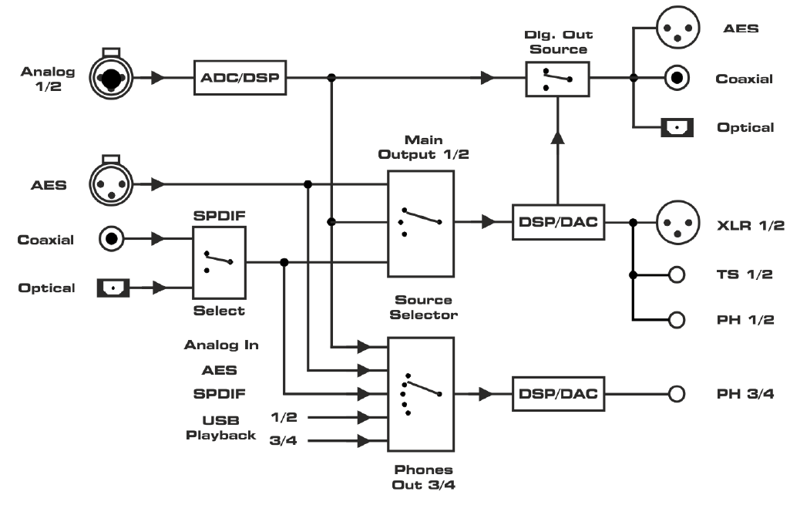
DAC/EQ setup
RME ADI-2 Pro FS R in AD/DA mode used as dual DAC
  Level matching
  Response EQ on direct drive
dd eq
dd feed
step-up feed

Slide 27
Some further reading on ESLs
UK Patent 815.978, Walker, Peter et al, 1955
Electrostatic Loudspeakers, Peter J. Baxandall
(Chapter 3 in Loudspeaker and Headphone Handbook, John Borwick, Editor)
The Design of Electrostatic Loudspeakers, Frank Verwaal, 2017, rev 2
Any diyaudio.com thread with Bolserst, Hans Polak and Stokesd
- Thanks for listening! -

Slide 28
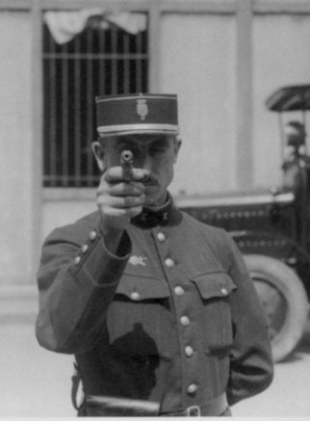
Questions?

Slide 29
System diagram
RCA
Audio
input
XLR
Symmetric signal
HV amp
Sig. sel.
Sig. det.
Mains
+5V stby
HV amp
Out
HV conn.
Stators
Out
Controller
Spkr sw.
Offset
Corona
Cable conn.
ON/OFF
Speaker sw.
+12V SMPS
Heaters
Mains
+/- 15V
Bip. Sup.
ON/OFF
+/- 2.2kV
HV sup.
h/w
interlock
Mains

Slide 30
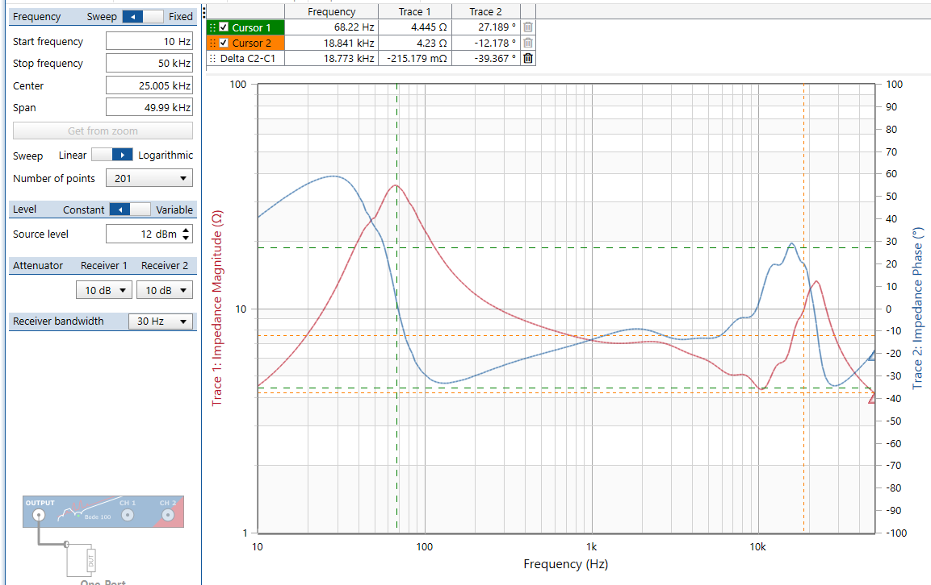
ESL 63 transformer input impedance

