Slide 1
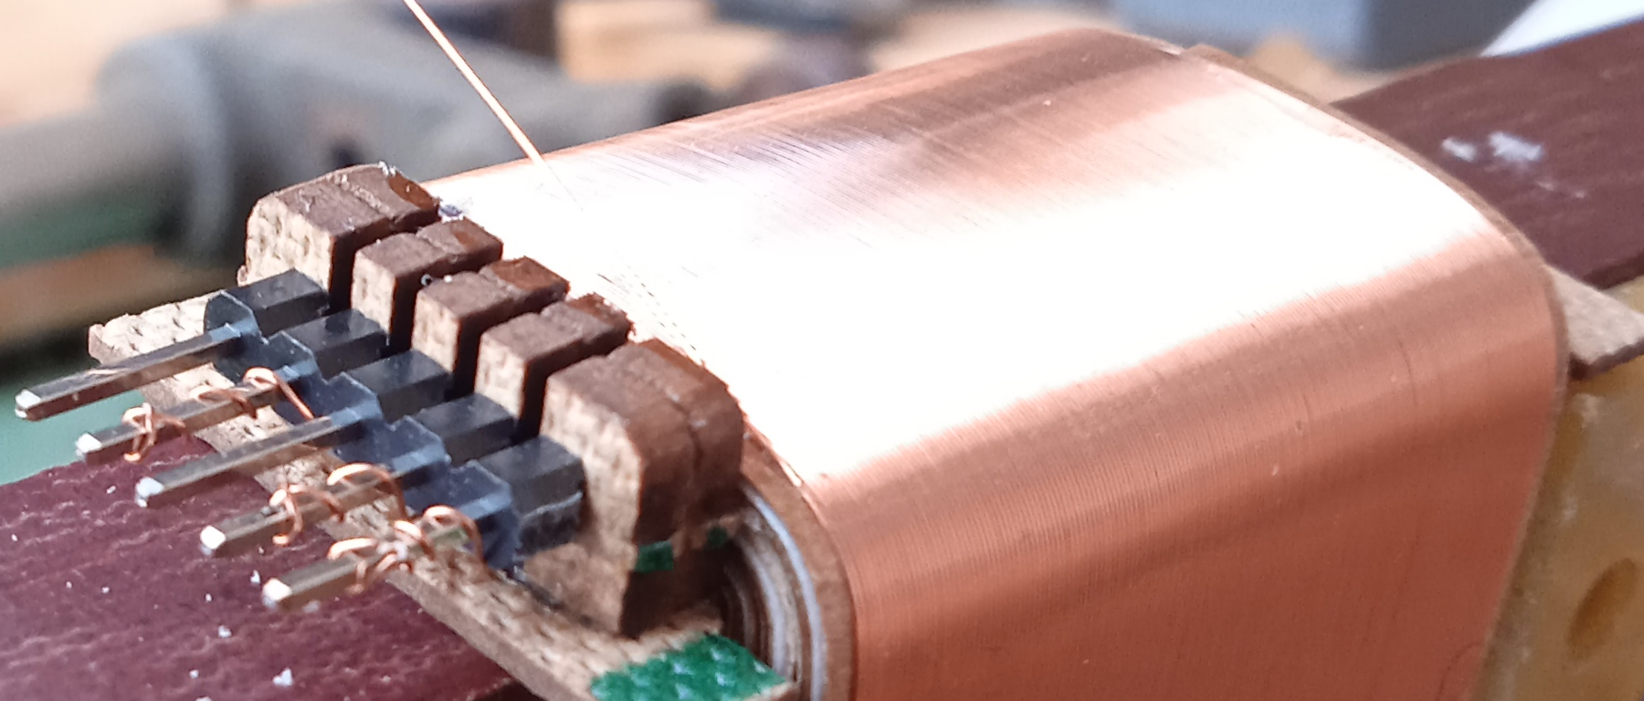
Advanced interleaving tips and tricks
By Alexander Naydenov,
Muse Coils Ltd.

Slide 2
Short summary about my work.
2016-2017. Obsessed with building transformers with good measurements. Good looking square waves, maximum frequency response extension, smooth roll-off.
2017-now. Stopped trusting measurements as reference for good sound after a lengthy subjective comparison of electrically identical projects with different sets of materials, such as wires, dielectrics. OFC, OCC copper, waxed paper, Nomex, etc.
2017-now. I kept spending time for RnD on measurements to squeeze HF “headroom” for bigger and harder projects, for example +100W output power SE OPTs, SE:PP interstages, big step up transformers, etc.
My current work is mostly based on “cookbook” snake oil approaches. The MinotauR series is based on 90% snake oil and 10% measurements.

Slide 3
Advanced interleaving is mostly about capacitance distribution.
Controlling capacitance by changing layer connections can be detrimental for your frequency response result.
I call one of the tricks the “capacitance dumping” technique. This means redirecting capacitance to less “offensive” areas inside the transformer coil, where they cause less trouble to the HF response.
We will see examples of P/S capacitance dumping to clumped primary capacitance, which is beneficial for most cases.
We’ll also observe at the influence of screen windings in a parallel connection and how they could improve the frequency response further.

Slide 4
For this ETF, I designed and measured two different transformers.
They both share IDENTICAL cores and COIL geometry, wires and dielectrics, but differently connected primary layers. Secondary layers are identically connected for both transformers.
Type: SE Line output transformer
Impedance ratio: 25,2k to 72R
Primary inductance: 140H ; Primary Idc = 10mA ;
Primary Vrms max = 185V @ 25Hz ; Btot = 1.5 T. HiB core
LF response with 5k Zgen – 6Hz @ -3dB ; unloaded secondary
Calculated leakage inductance: 80,5mH. Measured 86mH using LCR meter.
Rdc pri = 260R ; Rdc sec = 5.5R
Interleaving schematics, together with capacitance calculated values will be drawn on the white board.

Slide 5
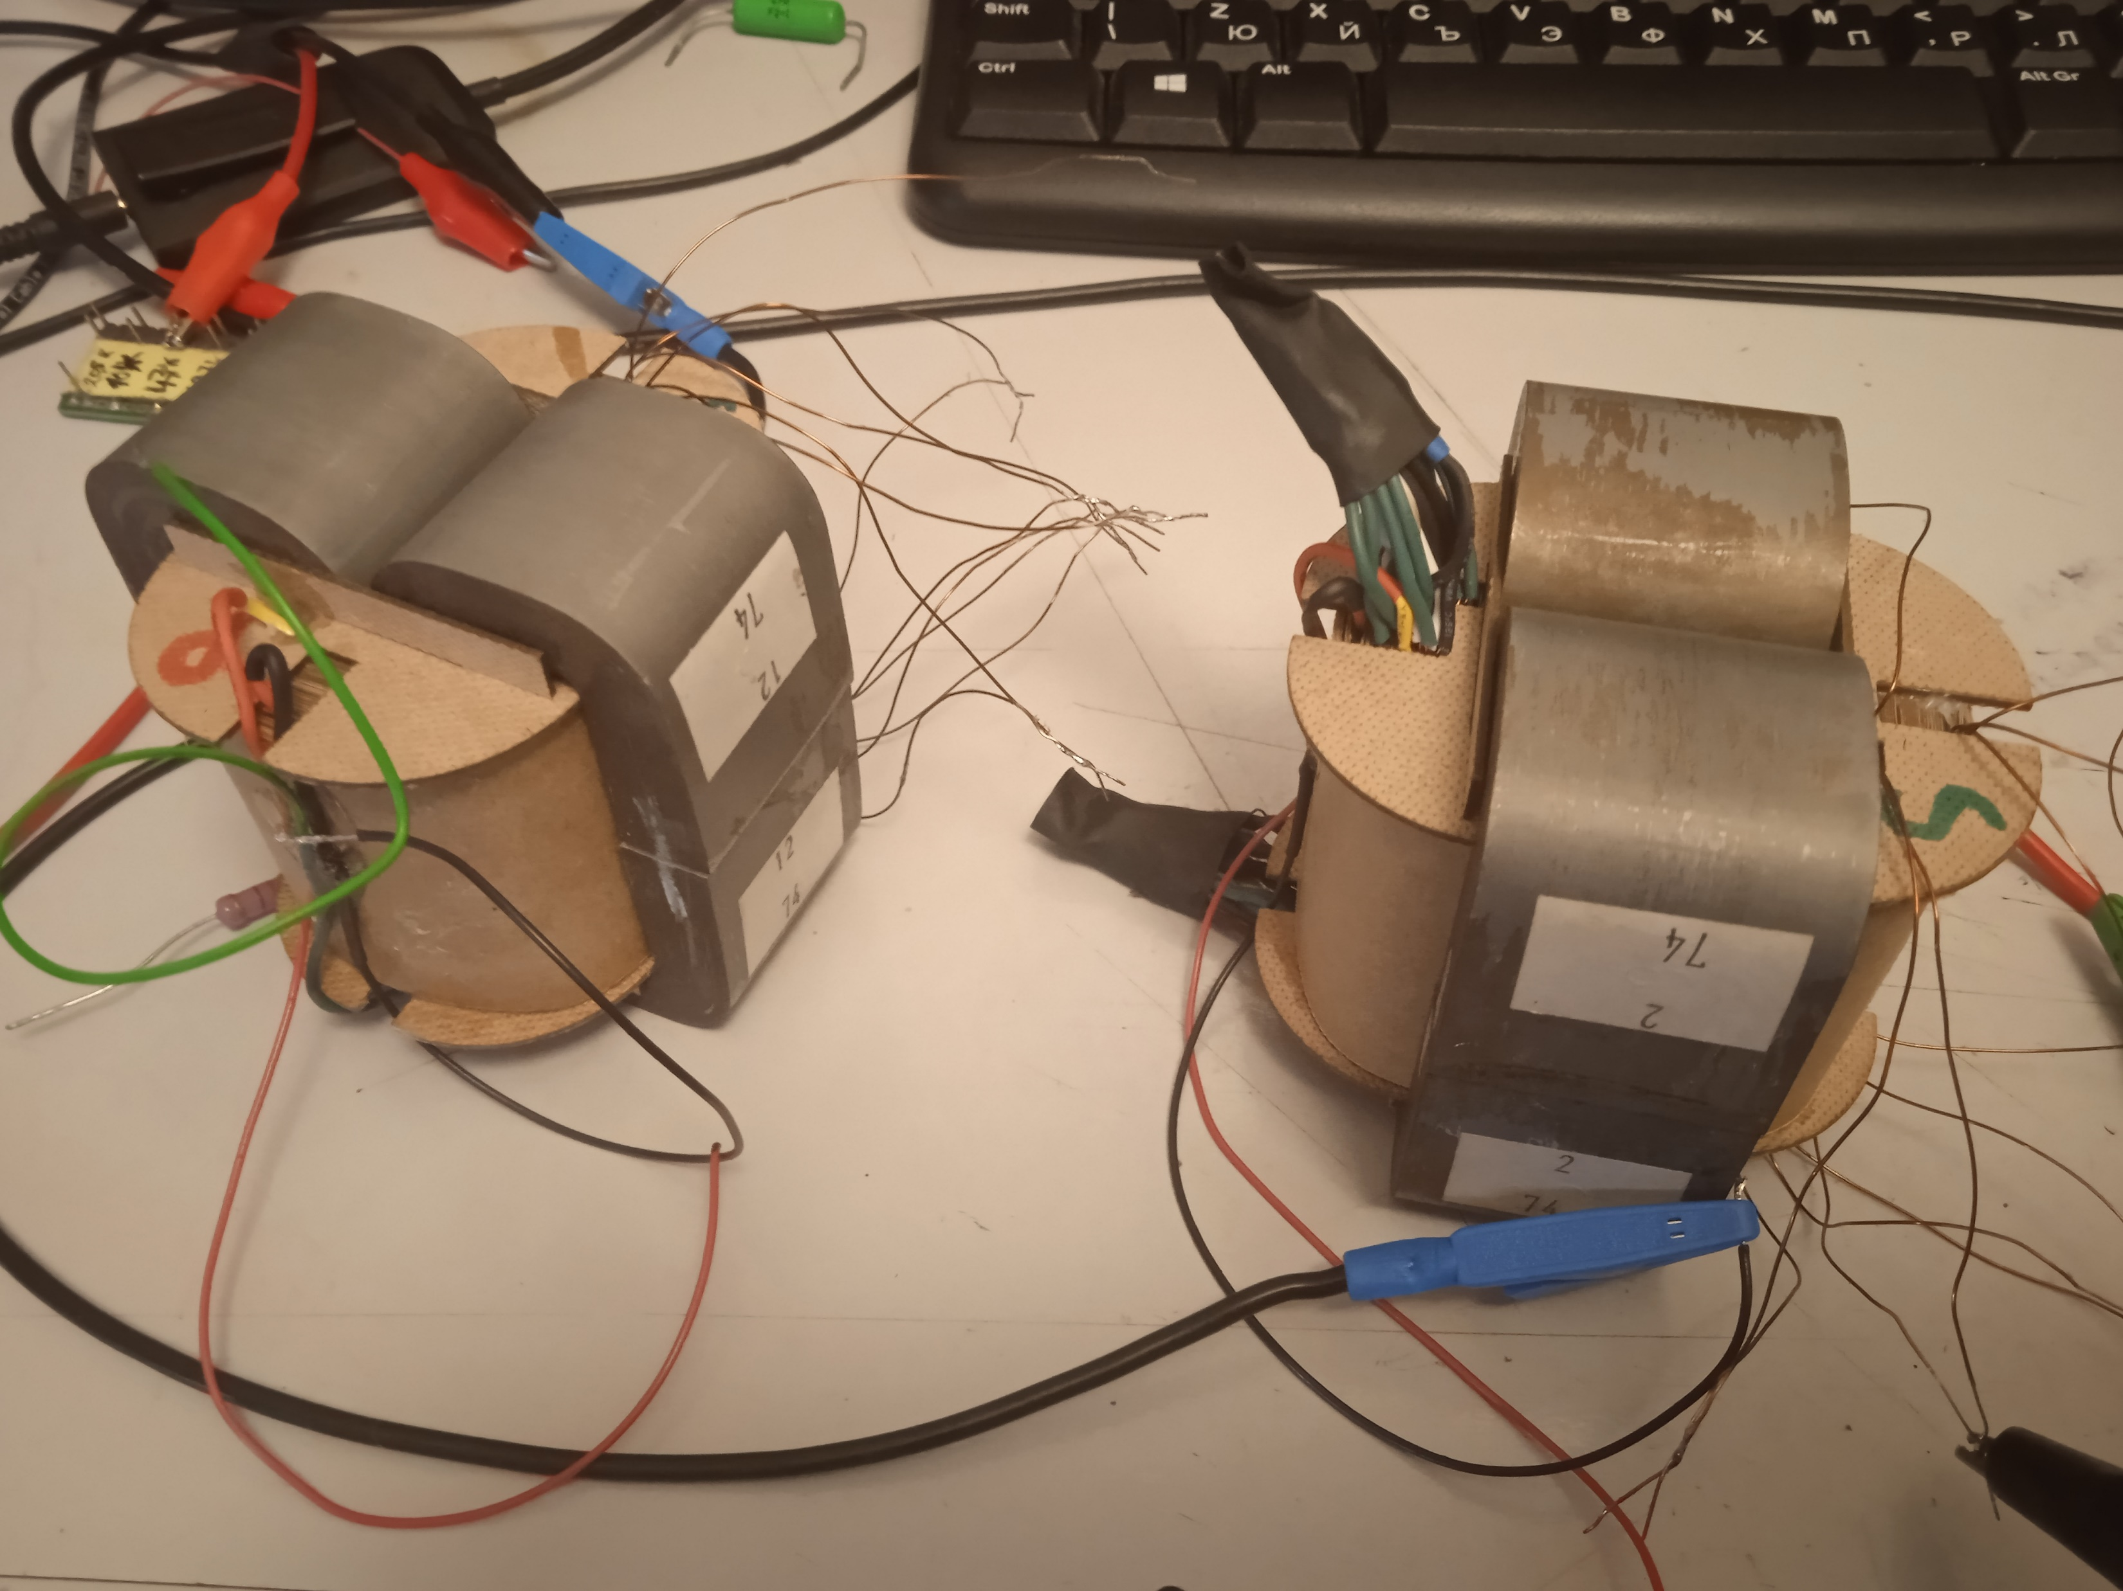
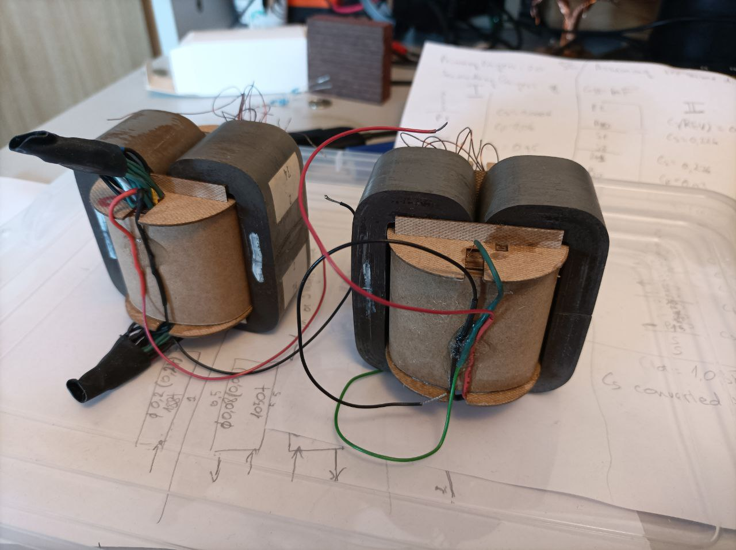

Slide 6
Frequency response testing conditions.
Velleman PCSU200 configured for 2.83V output|
100Hz to 1MHz frequency range
5dB per vertical division
4.7k generator output resistance using a series resistor
Tracing step 20% (the less, the better precision)
No averaging
Unloaded secondary for a better reveal of resonances due to Zpri / Ls roll-off.

Slide 7
MEASUREMENT 1 Screen layers all left floating, unconnected
ED1 (reference point)
-3dB @ 69kHz Dips (Ls/Cs) resonance: 100kHz ; ~240kHz Peaks (Ls/Cp) resonance: 200kHz ; 340kHz
ED2
-3dB @ 155kHz Dips (Ls/Cs) resonance: 200kHz ; 320kHz Peaks (Ls/Cp) resonance: 290kHz ; 510kHz

Slide 8
MEASUREMENT 2 Let’s turn on the screens. They are in parallel, but not connected anywhere
ED1
-3dB @ 69kHz Dips (Ls/Cs) resonance: 100kHz ; 240kHz Peaks (Ls/Cp) resonance: 200kHz, ~340kHz
ED2
-3dB @ 165kHz Dips (Ls/Cs) resonance: 120 kHz ; 200kHz Peaks (Ls/Cp) resonance: 300kHz

Slide 9
MEASUREMENT 3 Screens connected with one end to ground, negative polarity lead
ED1
-3dB @ 83kHz Dips (Ls/Cs) resonance: ~130kHz Peaks (Ls/Cp) resonance: ~180kHz
ED2
-3dB @ 330kHz Dips (Ls/Cs) resonance: ~120kHz ; 200kHz Peaks (Ls/Cp) resonance: 100kHz, 290kHz

Slide 10
MEASUREMENT 4 Screens connected with one end to ground, positive polarity lead
ED1
-3dB @ 250kHz Dips (Ls/Cs) resonance: 100kHz ; ~190kHz Peaks (Ls/Cp) resonance: ~140kHz ; 280kHz
ED2
-3dB @ 110kHz Dips (Ls/Cs) resonance: ~120kHz ; 210kHz Peaks (Ls/Cp) resonance: 100kHz ; 200kHz ; 290kHz

Slide 11
BONUS = f**king things up Screens connected to anode Doesn’t really matter which end.
ED1
-3dB @ ~14.5kHz
ED2
-3dB @ 14,2kHz

Slide 12
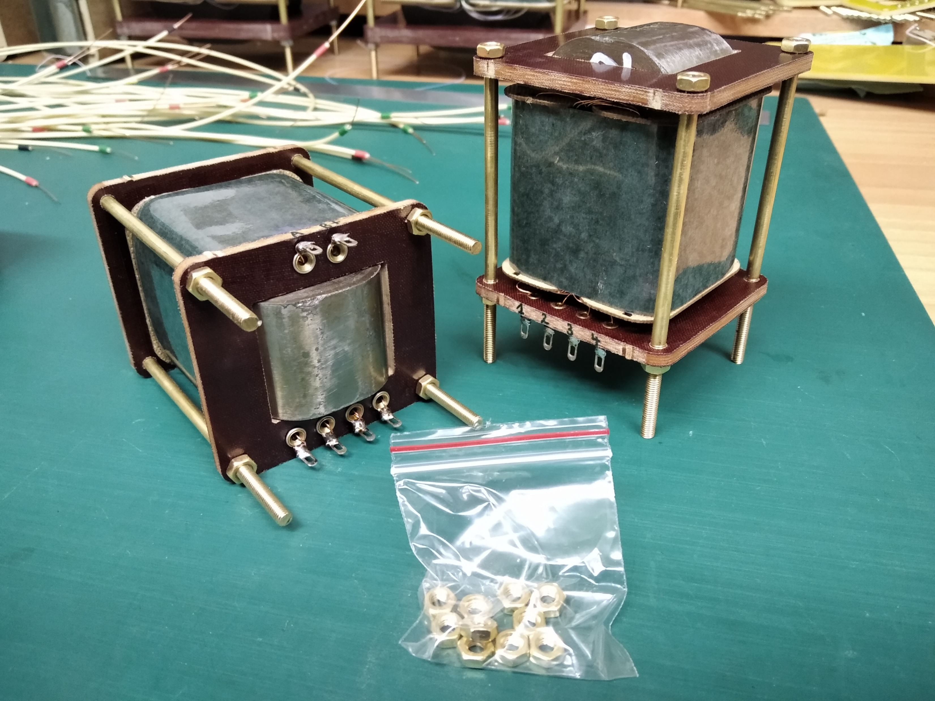
DHT Rob’s first interstage where I applied the “screen” windings technique. Back then I called it the “military” or “police” windings. Because they put stuff into order

